Slide 1
Disclaimer
The material contained in this PPT is a raw model output and research product.
This is meant for scientific use only.

Slide 2
EXPERIMENTAL LIGHTNING FLASH PREDICTION-VERIFICATION
Real-time forecast based on
INITIAL CONDITION (IC): (a) 21022019 0000 UTC (GFS T1534)
(b) 05042019 0000 UTC (GFS T1534)
(c) 06042019 1200 UTC (GFS T1534)
(d) 07042019 1200 UTC (GFS T1534)
WRF (With DLP-scheme)- 3 km resolution
Prepared by: K Gayatri Vani, Greeshma M. Mohan, Anupam Hazra, Chandrima Mallick, Samir Pokhrel, H. S. Chaudhari and Team for Lightning/TS forecast, Indian Institute of Tropical Meteorology, Ministry of Earth Sciences, India.

Slide 3
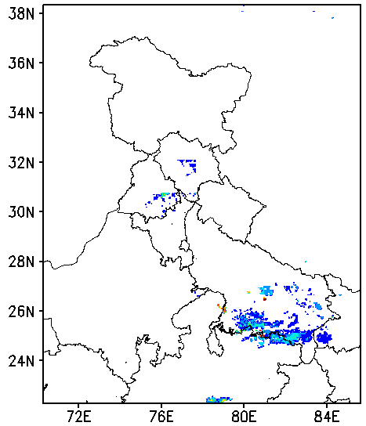
24 h Accumulated Total Lightning flash counts
(Forecast for 21 Feb 2019)
Model
Observation

Slide 4
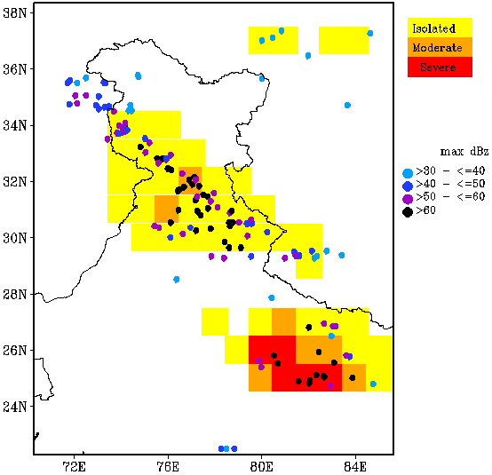
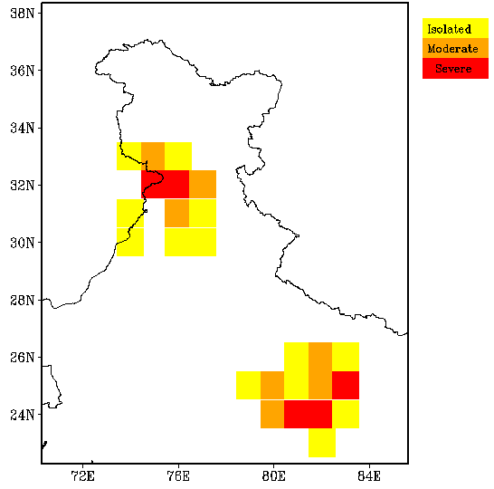
24 h Accumulated Lightning Threat
(Forecast for 21 Feb 2019)
Model
Observation

Slide 5
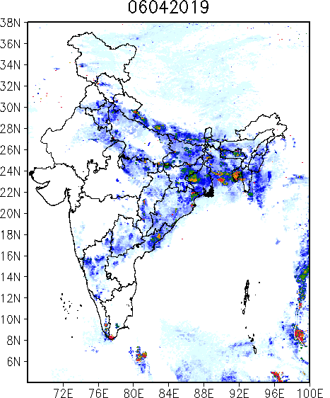
24 h Accumulated Total Lightning flash counts
(Forecast for 06 April 2019)
Model
Observation

Slide 6
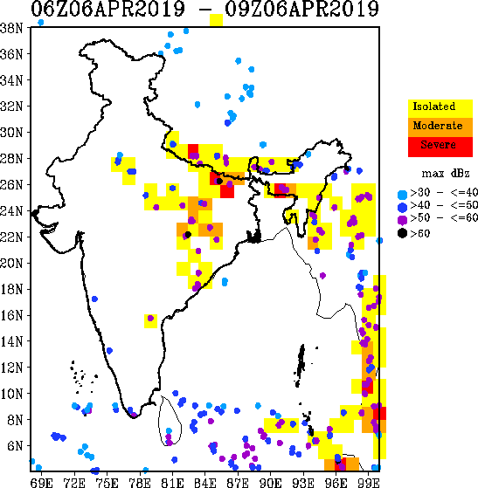
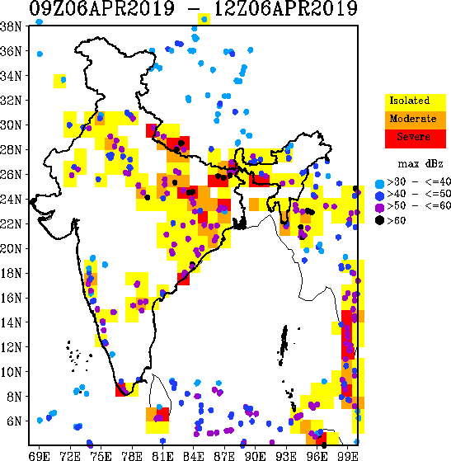
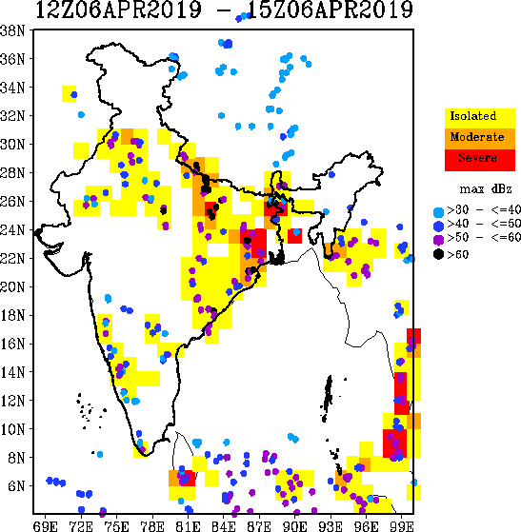
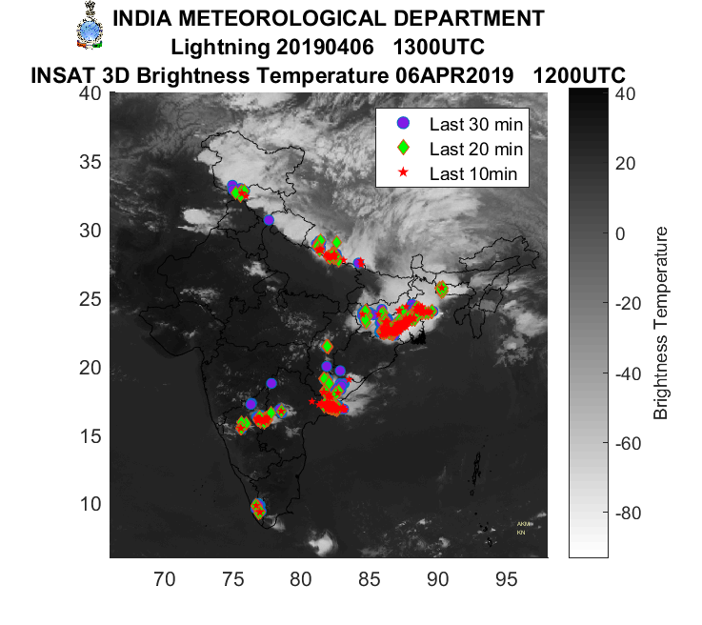
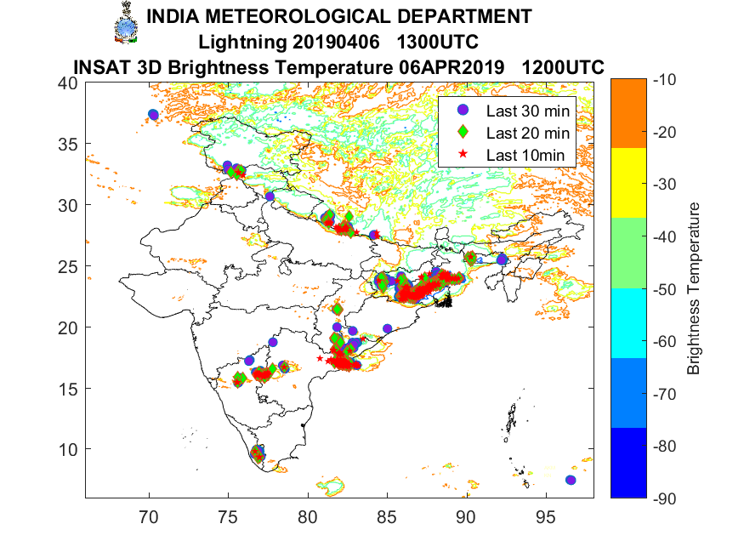

Slide 7
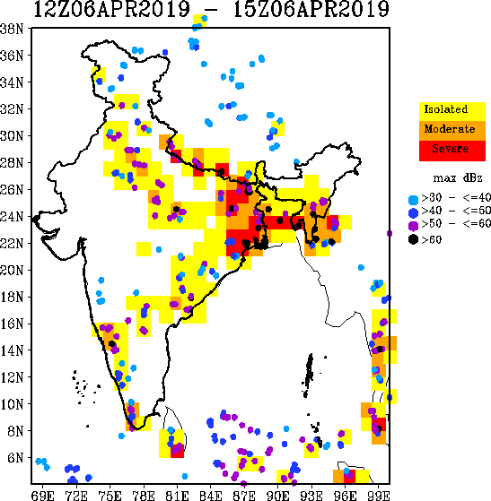
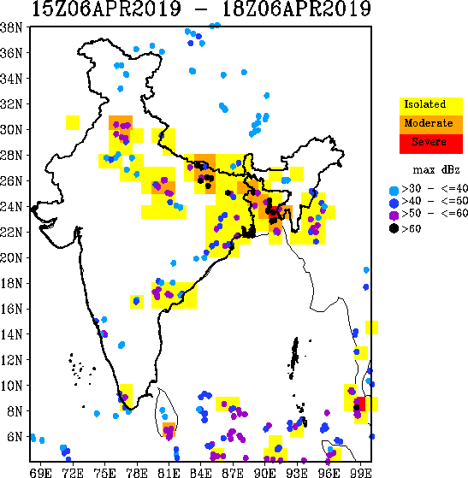
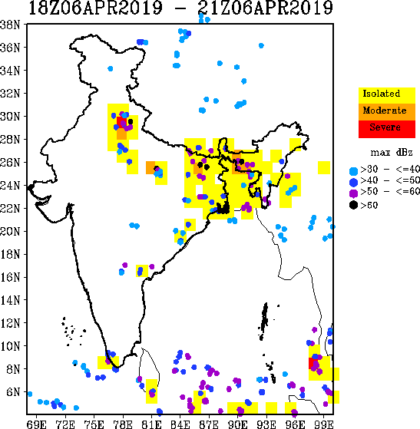
Forecast for: 06 April 2019
Observation (Lightning network) – Screen shot)
IMD report: Kolkata and experiencing severe thunderstorm, gusty wind and lightning since around 6PM.
Thunderstorm and lightning also happening over coastal Odisha and also many places of gangetic planes.
12 Z
13 Z
14 Z

Slide 8
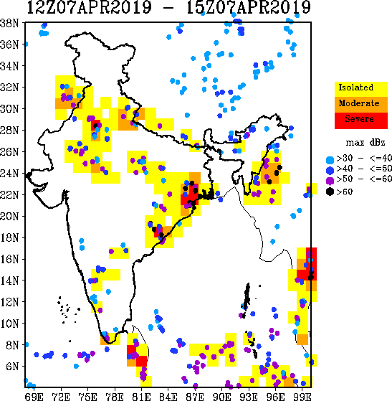
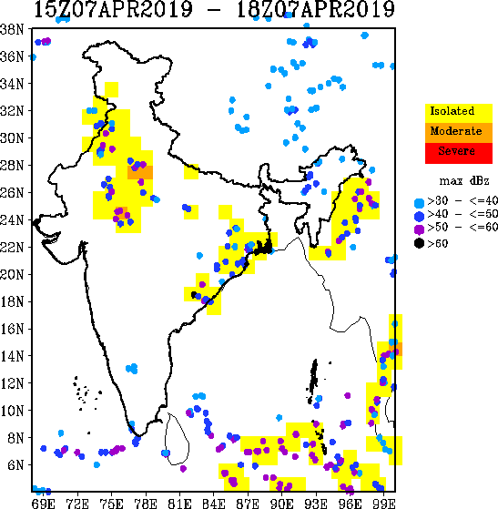
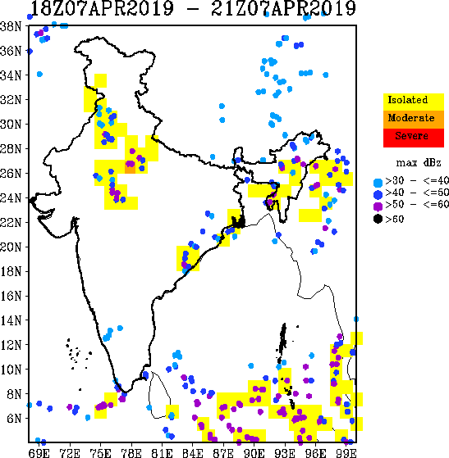
Forecast for: 07 April 2019

Slide 9
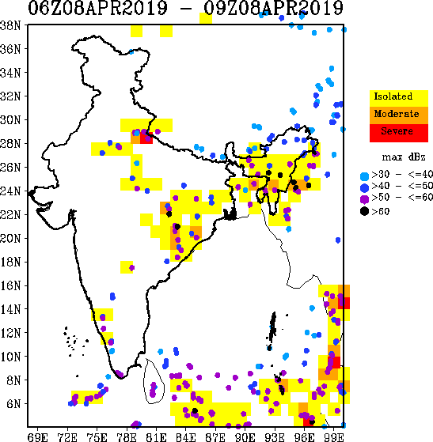
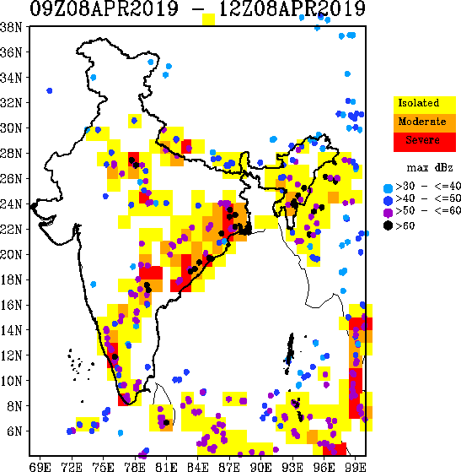
Forecast for: 08 April 2019

Slide 10
Thanks ……

