Slide 1
Disclaimer
The material contained in this PPT is a raw model output and research product.
This is meant for scientific use only.

Slide 2
EXPERIMENTAL LIGHTNING FLASH PREDICTION
Real-time forecast based on
INITIAL CONDITION (IC): 20032021 1200UTC (GFS T1534)
WRF (With DLP-scheme)- 3 km resolution
Note: Includes Only Day1(21032021) and Day2(22032021)
Prepared by: Greeshma M. Mohan, K Gayatri Vani, Anupam Hazra and Team for Lightning/TS forecast, Indian Institute of Tropical Meteorology, Ministry of Earth Sciences, India.

Slide 3
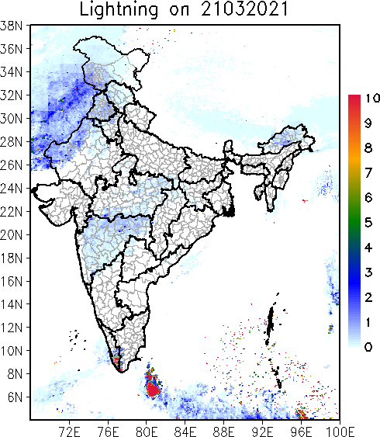
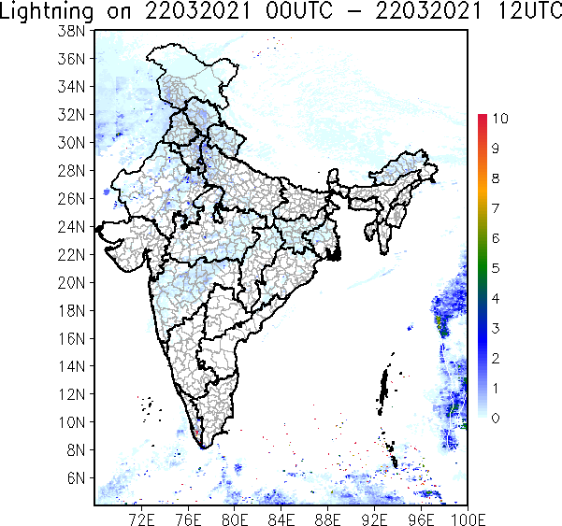
24 hr Accumulated Total Lightning Flash Counts

Slide 4
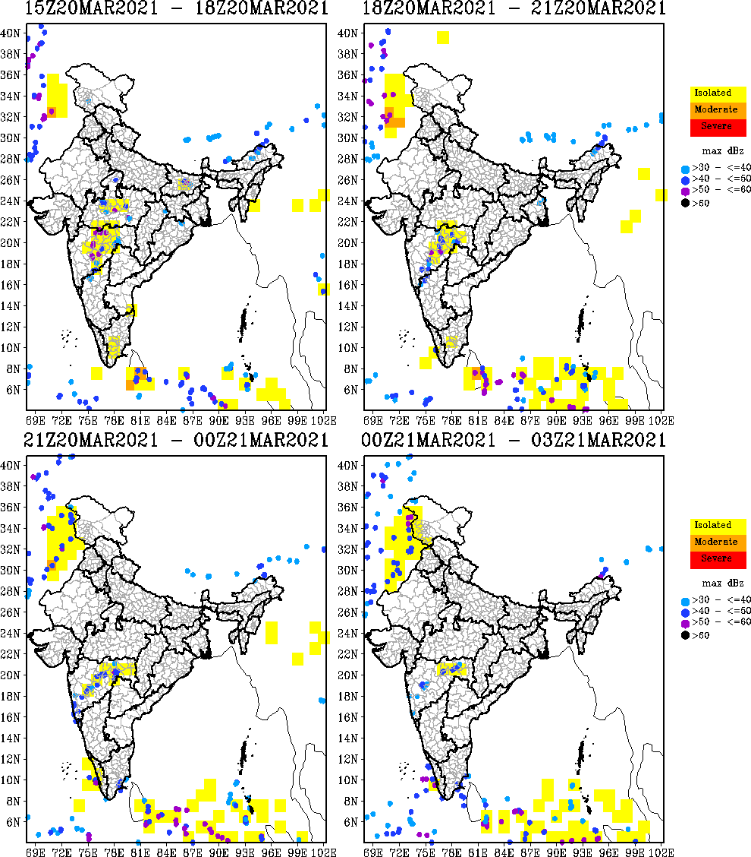
3 hourly Accumulated Total Lightning Flash Count (Max. Reflectivity overlaid)

Slide 5
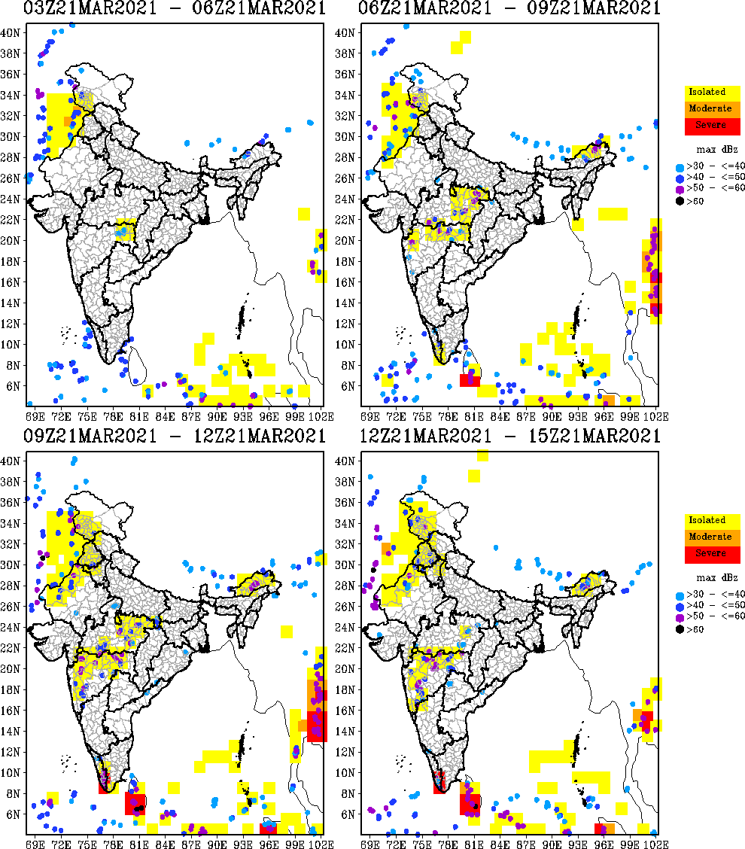
3 hourly Accumulated Total Lightning Flash Count (Max. Reflectivity overlaid)

Slide 6
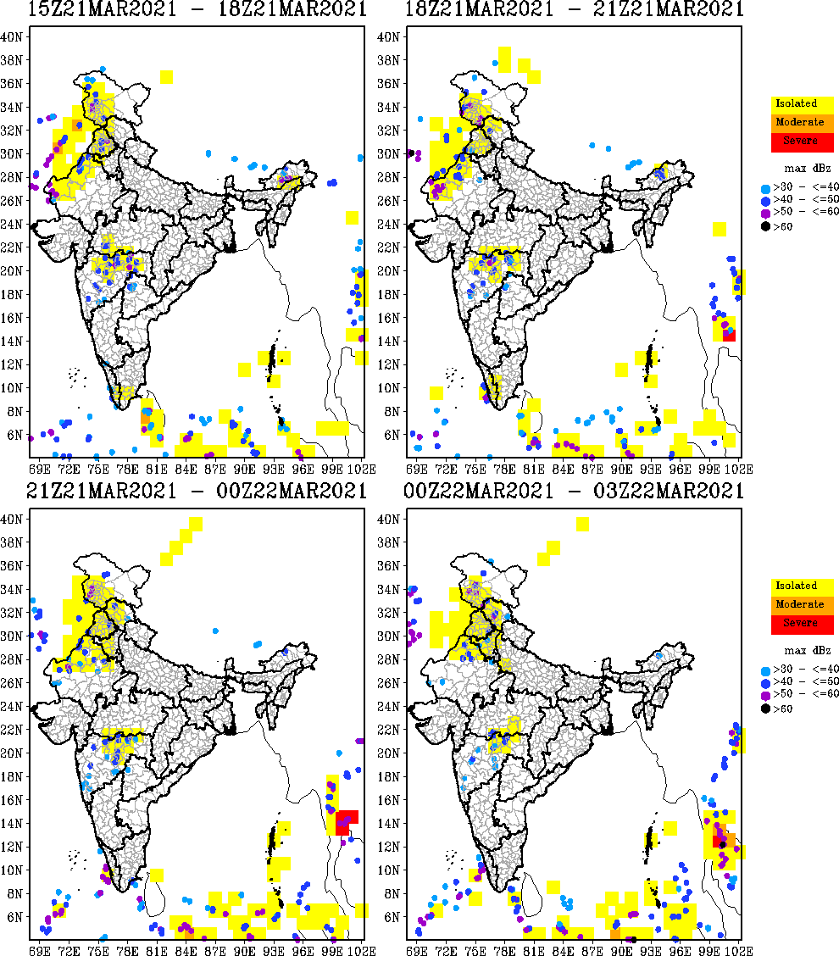
3 hourly Accumulated Total Lightning Flash Count (Max. Reflectivity overlaid)

Slide 7
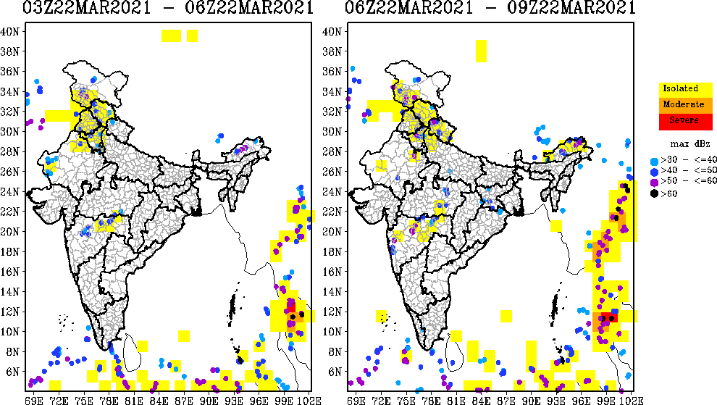
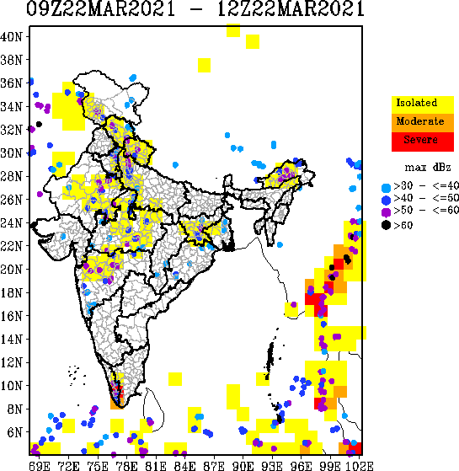
3 hourly Accumulated Total Lightning Flash Count (Max. Reflectivity overlaid)

Slide 8
Thanks ……

