Slide 1

Disclaimer
The material contained in this PPT is a raw model output and research product.
This is meant for scientific use only.

Slide 2

EXPERIMENTAL LIGHTNING FLASH PREDICTION
Real-time forecast based on
INITIAL CONDITION (IC): 26072019 0000UTC (GFS T1534)
WRF (With DLP-scheme)- 3 km resolution
Note: Includes Day1 (26072019)
Prepared by: Greeshma M. Mohan, K Gayatri Vani, Anupam Hazra, Chandrima Mallick and Team for Lightning/TS forecast, Indian Institute of Tropical Meteorology, Ministry of Earth Sciences, India.

Slide 3
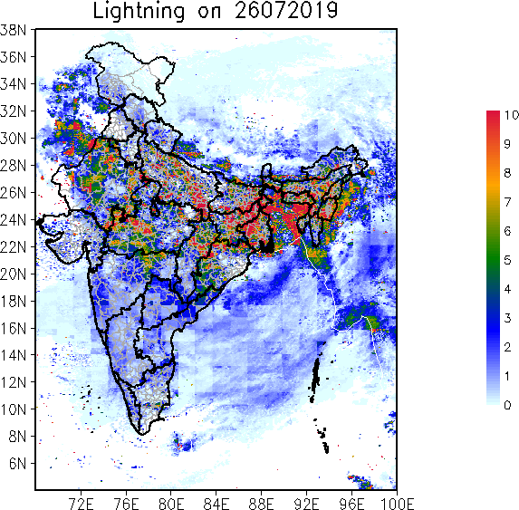
24 hr Accumulated Total Lightning Flash Counts (Day1)

Slide 4
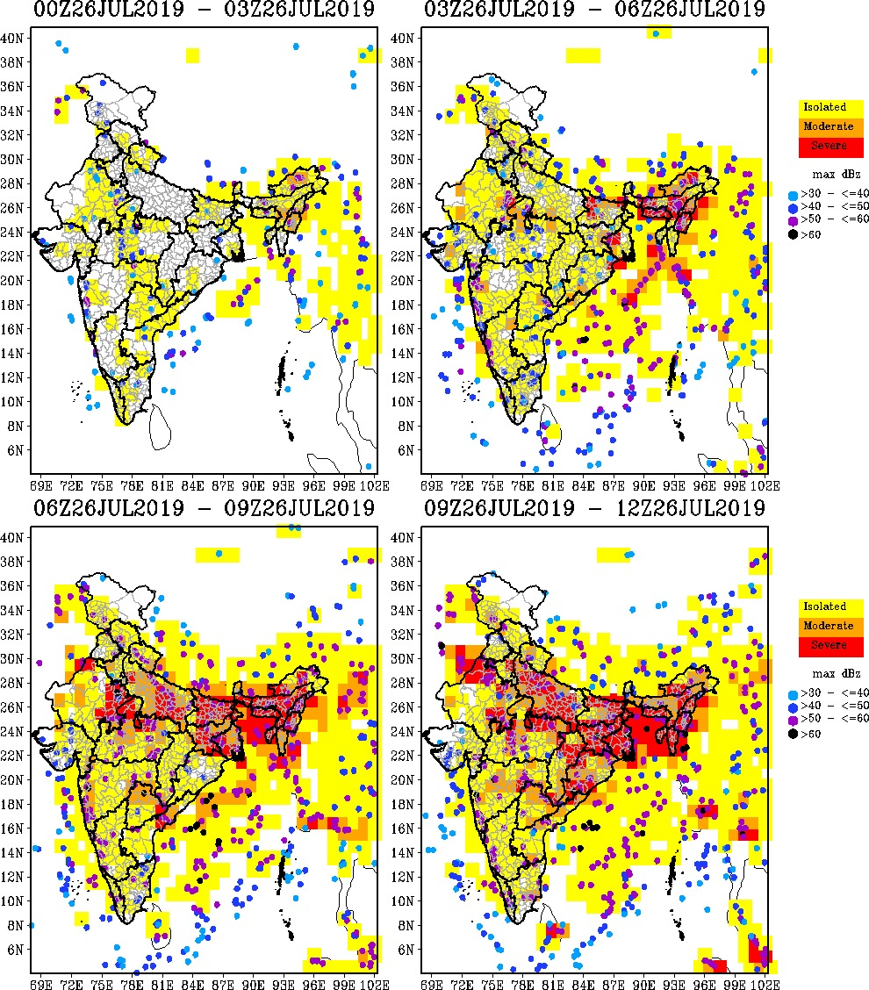
3 hourly Accumulated Total Lightning Flash Count (Max. Reflectivity overlaid)

Slide 5
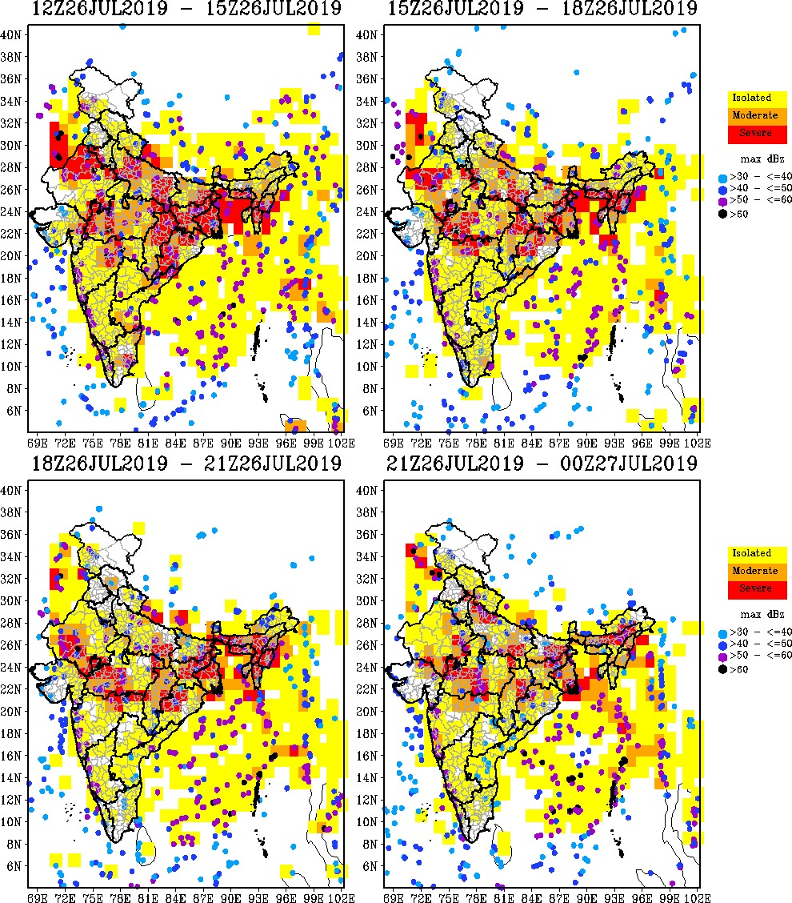
3 hourly Accumulated Total Lightning Flash Count (Max. Reflectivity overlaid)

Slide 6
Thanks ……

