Slide 1
Disclaimer
The material contained in this PPT is a raw model output and research product.
This is meant for scientific use only.

Slide 2
EXPERIMENTAL LIGHTNING FLASH PREDICTION-VERIFICATION
Real-time forecast based on
INITIAL CONDITION (IC): 18042019 0000UTC (GFS T1534)
WRF (With DLP-scheme)- 3 km resolution
Prepared by: K Gayatri Vani, Greeshma M. Mohan, Anupam Hazra, Chandrima Mallick, Samir Pokhrel, H. S. Chaudhari and Team for Lightning/TS forecast, Indian Institute of Tropical Meteorology, Ministry of Earth Sciences, India.

Slide 3
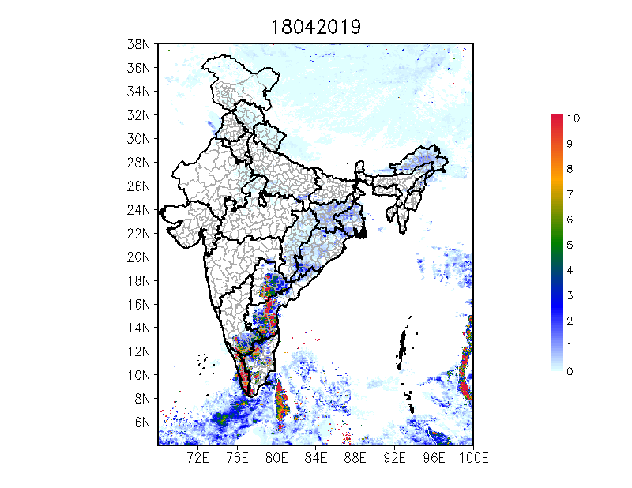
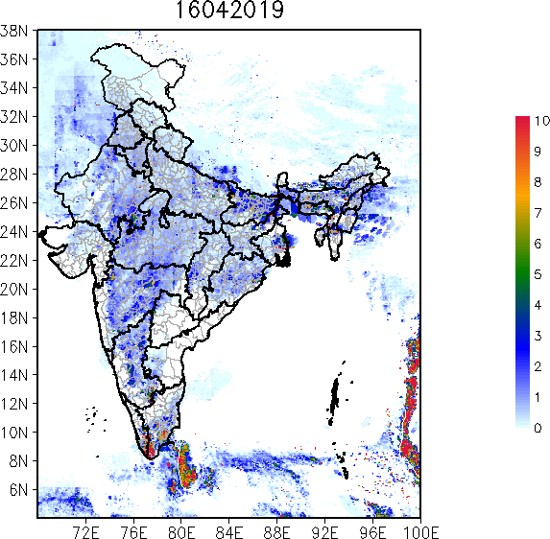
24 hr Accumulated Total Lightning Flash Counts (Day1)
Notes:
3

Slide 4
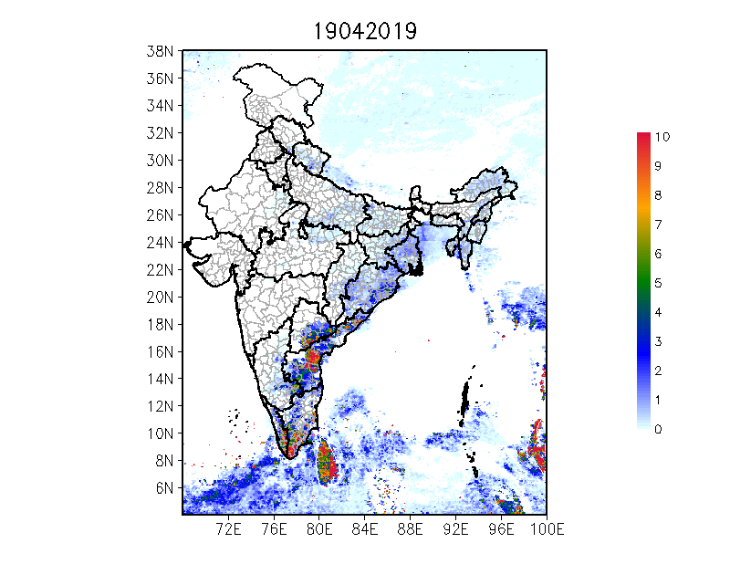
24 hr Accumulated Total Lightning Flash Counts (Day2)
Notes:
4

Slide 5
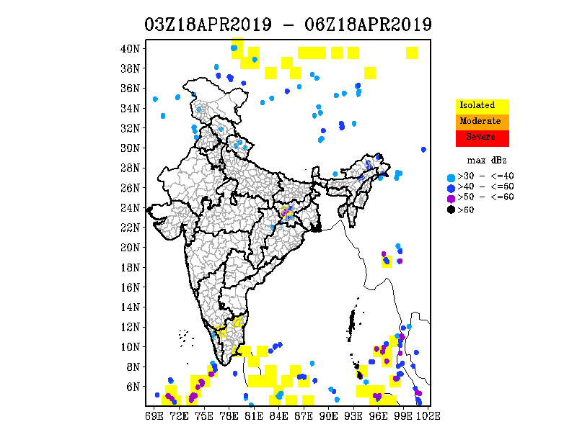
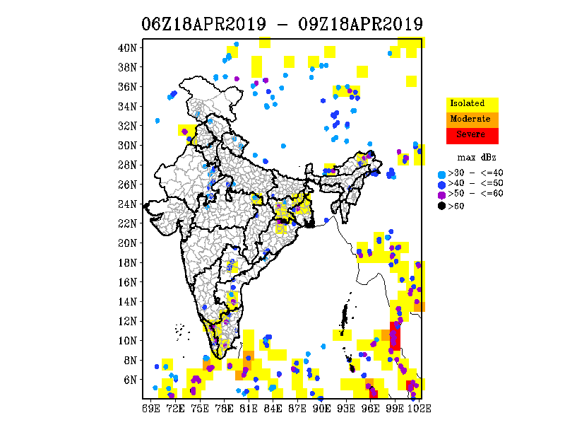
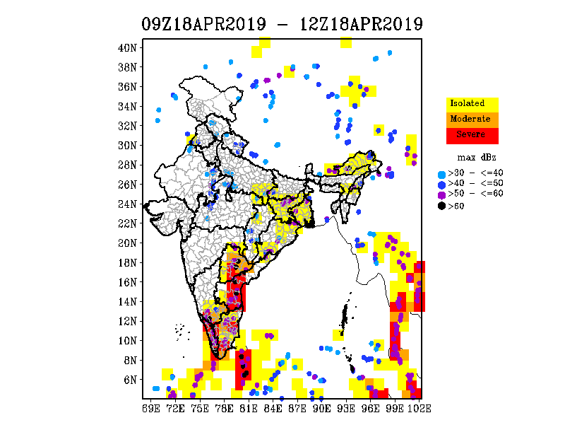
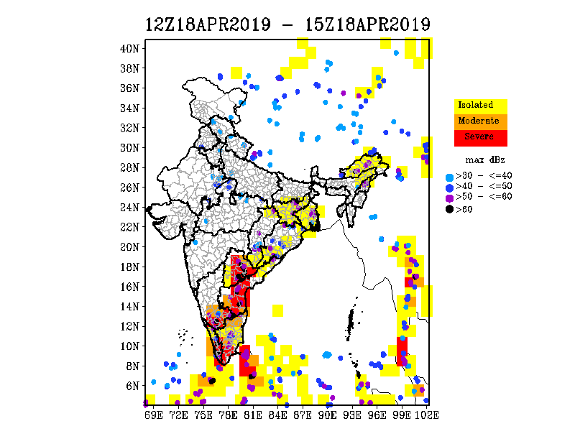
3 hourly Accumulated Total Lightning Flash Count (Max. Reflectivity overlaid)

Slide 7
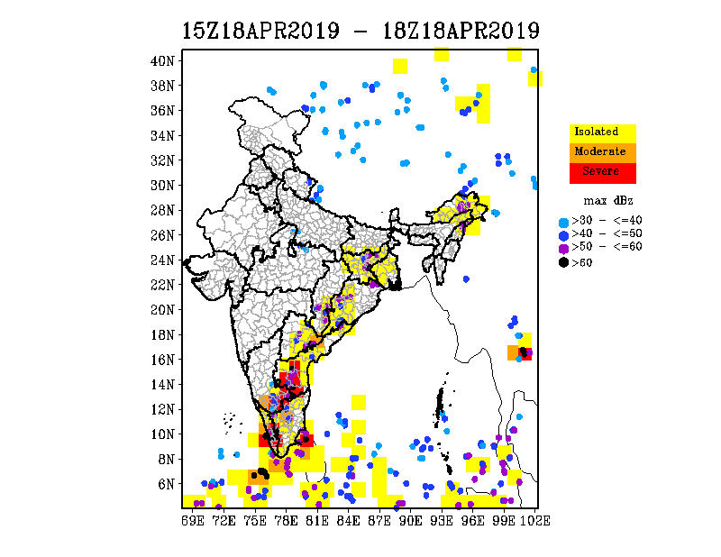
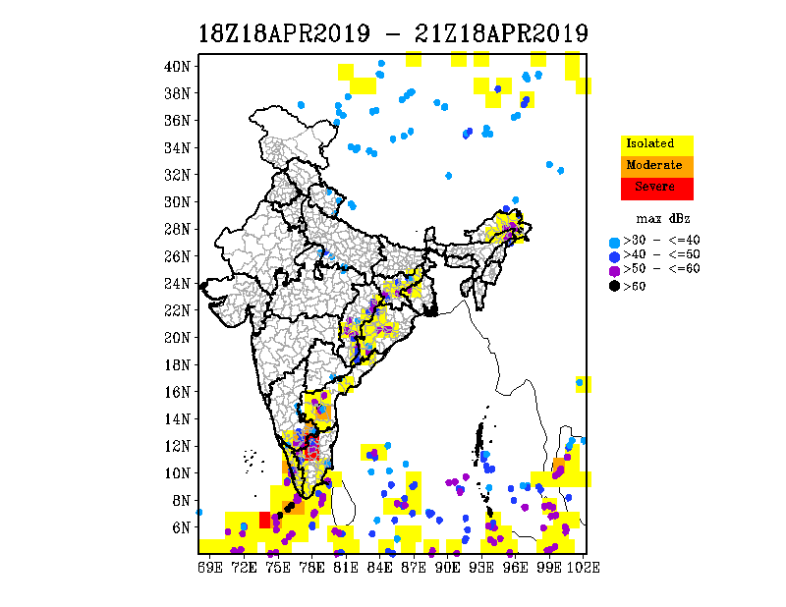
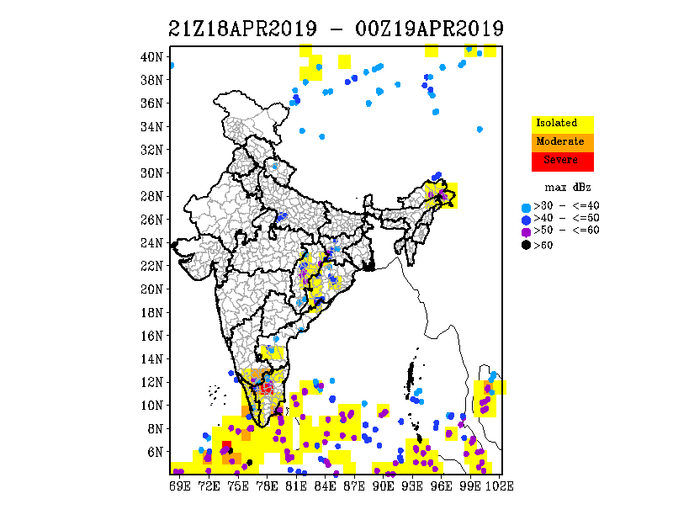
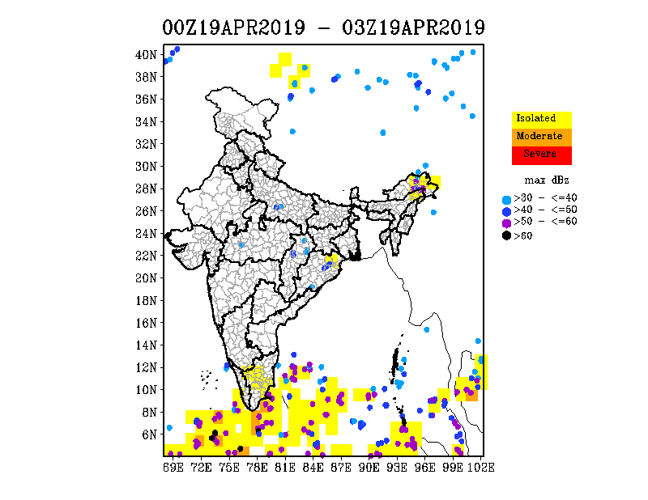
3 hourly Accumulated Total Lightning Flash Count (Max. Reflectivity overlaid)

Slide 8
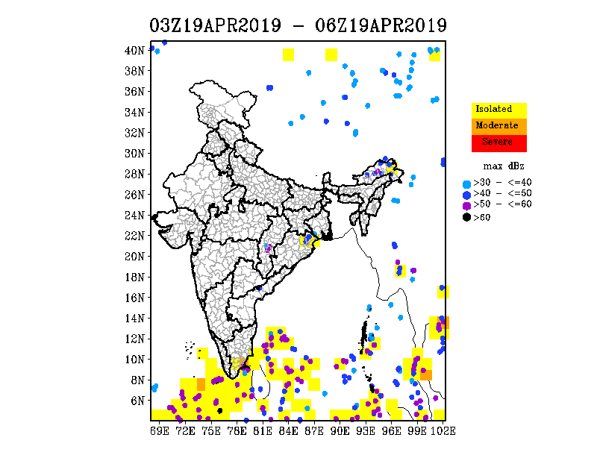
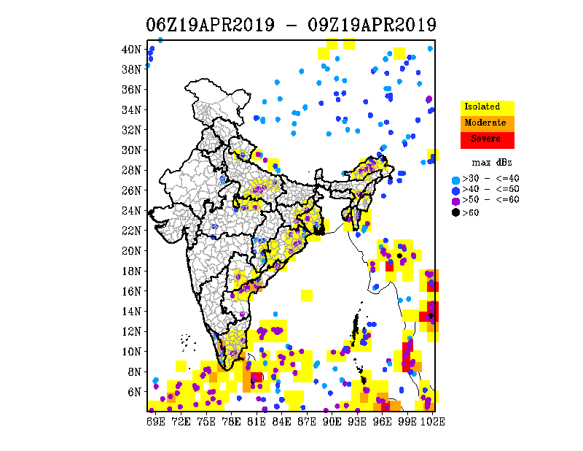
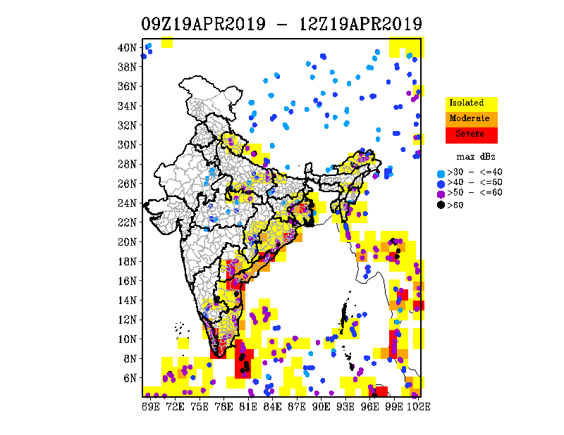
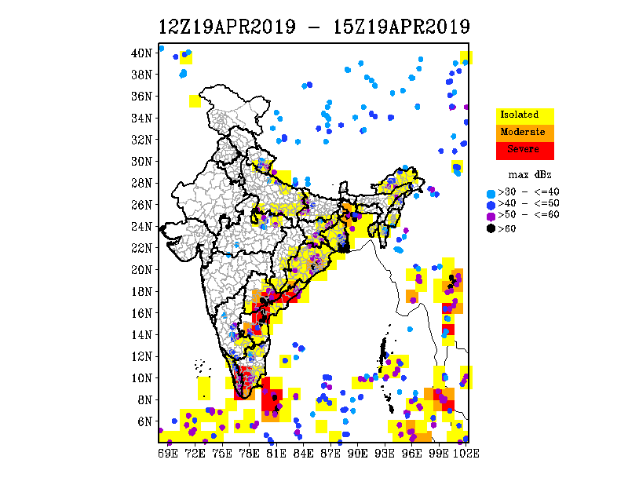
3 hourly Accumulated Total Lightning Flash Count (Max. Reflectivity overlaid)

Slide 9
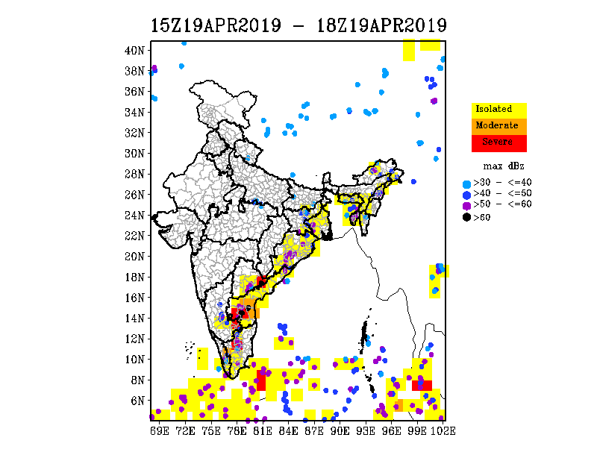
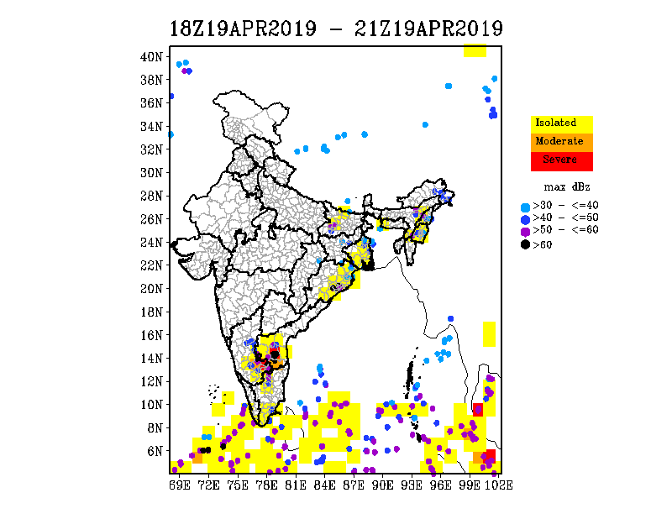
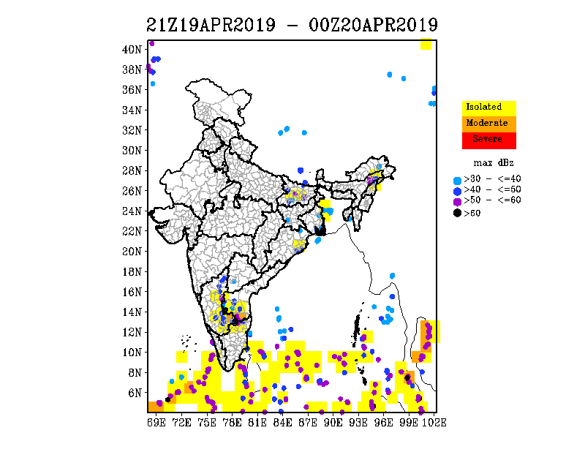
3 hourly Accumulated Total Lightning Flash Count (Max. Reflectivity overlaid)

Slide 10
Thanks ……

Slide 11
Verification

