Slide 1
Prediction of Lightning Potential and other TS indices based on IMD-WRF (3Km) for day1

Slide 2


Slide 3
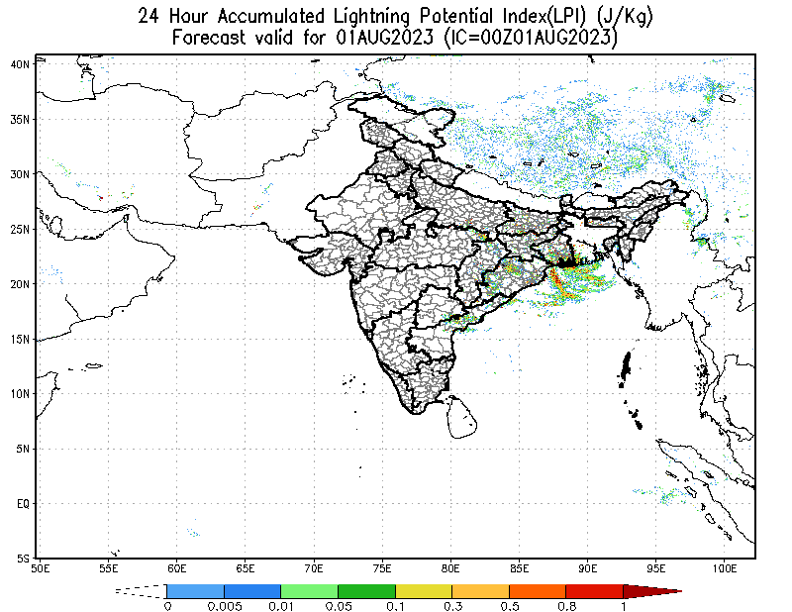

Slide 4


Slide 5
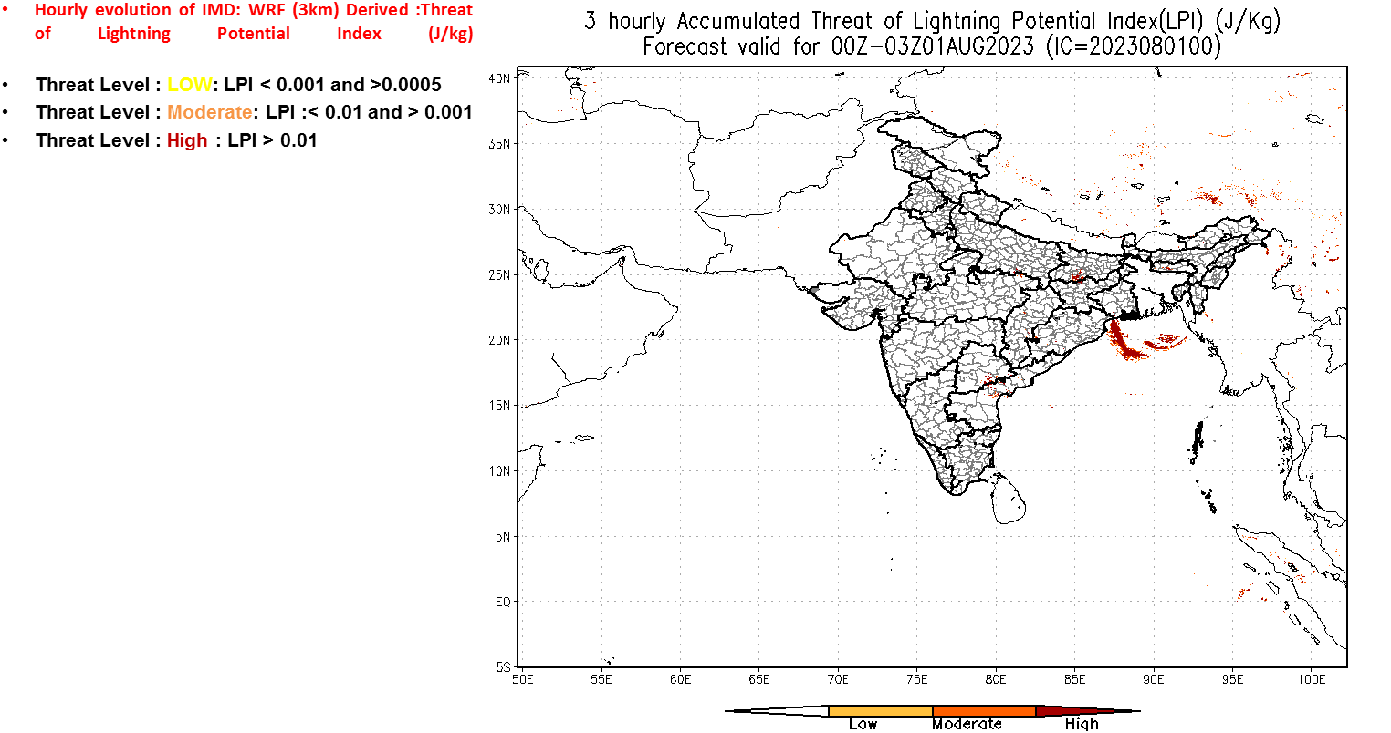

Slide 6


Slide 7
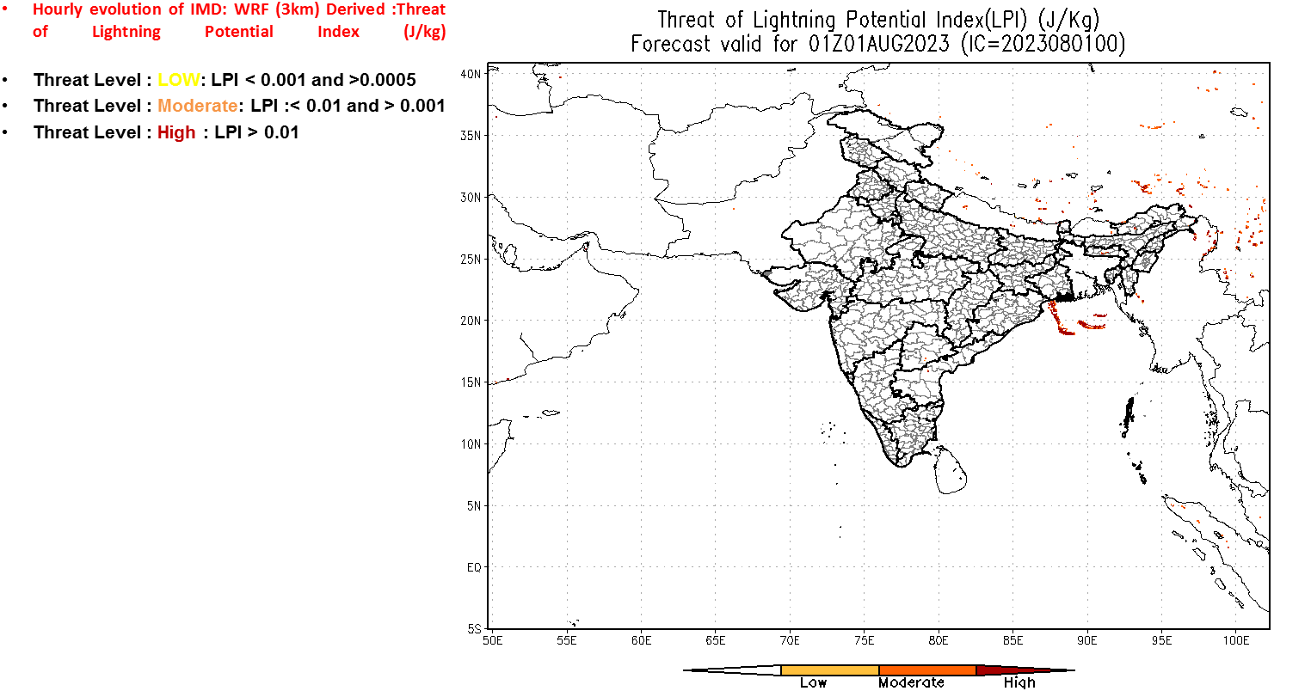

Slide 8
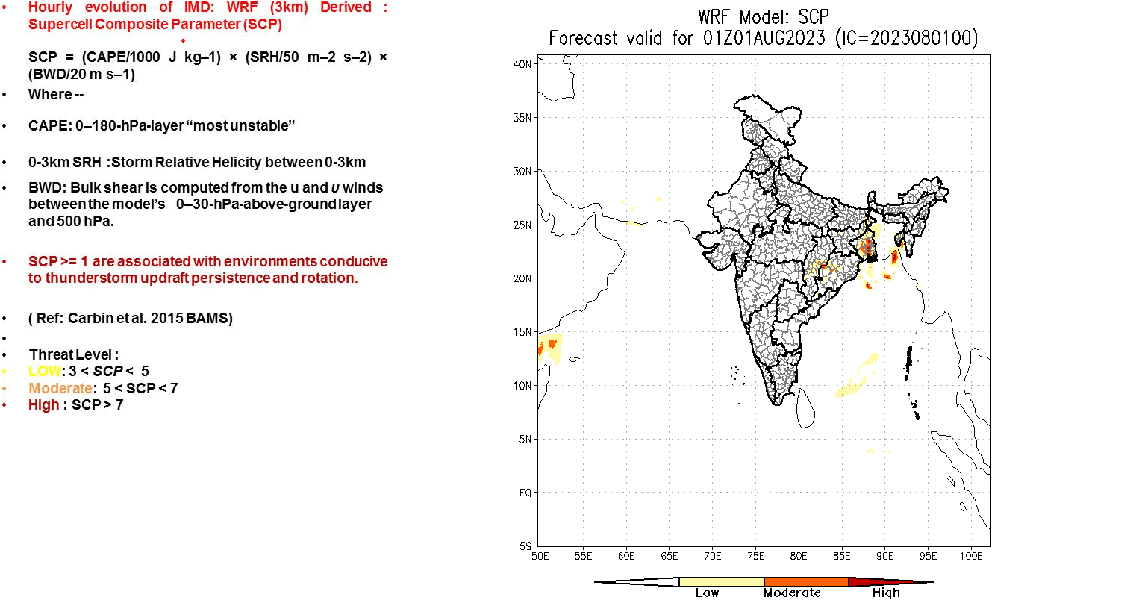

Slide 9
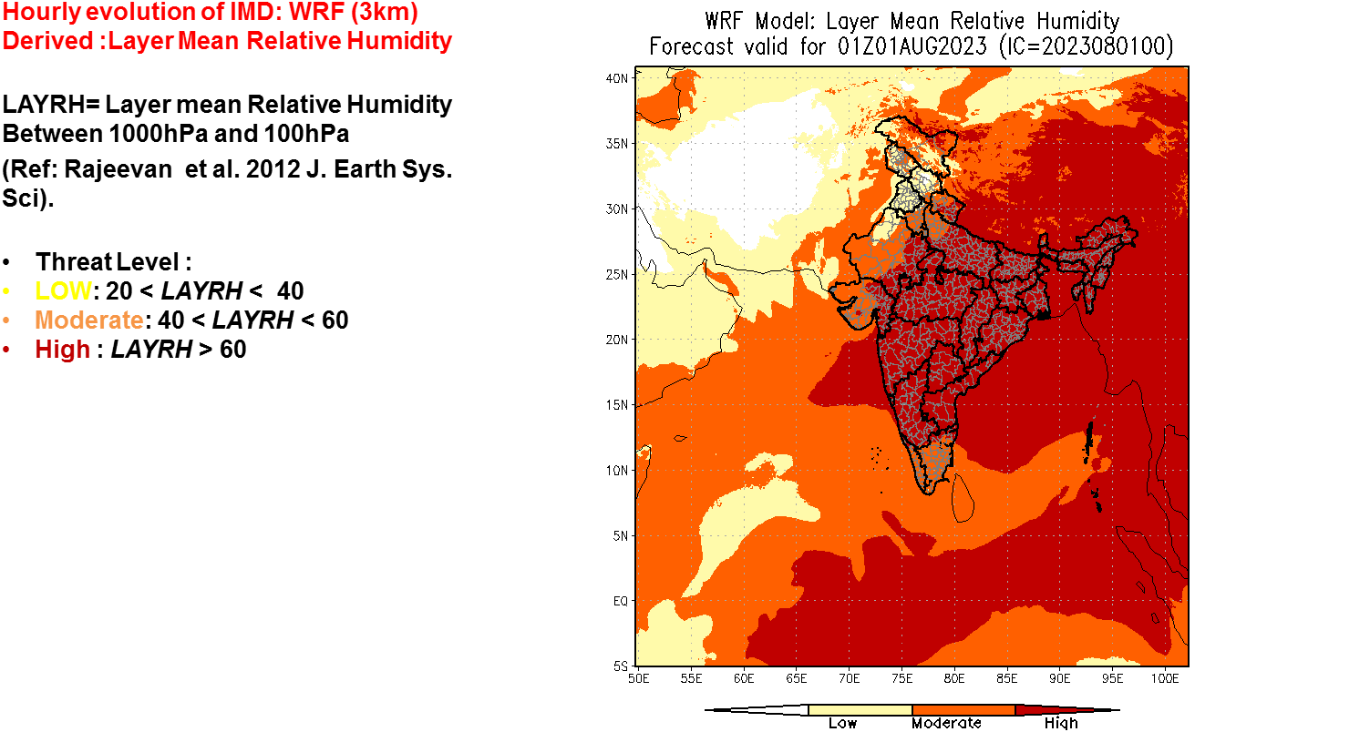

Slide 10
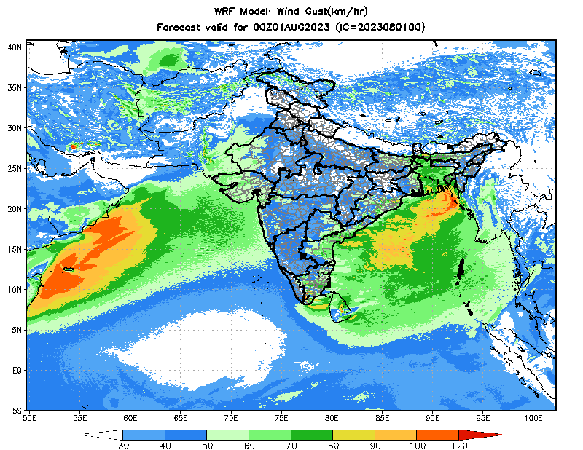

Slide 11
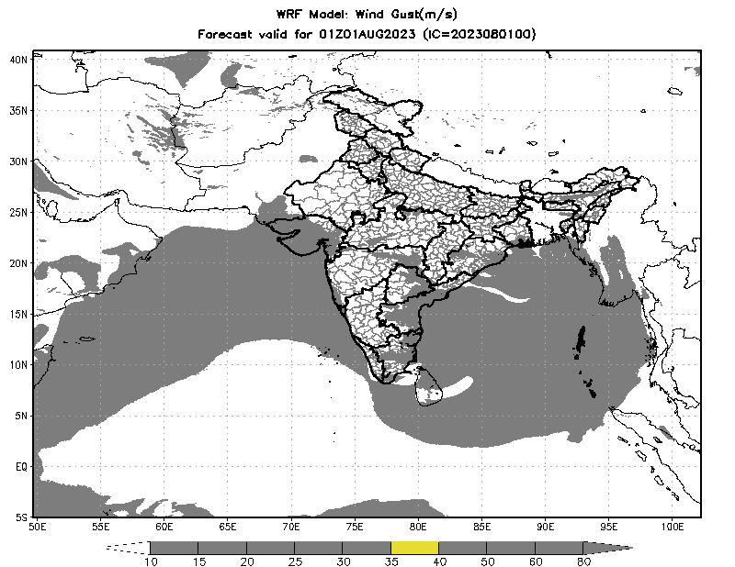

Slide 12


